Slide 1

Most GUI class libraries in C++ are platform specific
  Different hardware capabilities
  Subtle differences between the "look-and-feel" of various Windowing operating systems
Abstract Window Toolkit (AWT) is cross-platform
  Swing can observe various OS look-and-feel conventions

Slide 2

Toolkit -------------------------------------------------- AWT
-----------|------------
Button List JVM
| | Native GUI
Button Peer List Peer (Windows, Mac, X)
AWT GUI classes are platform-independent elements
Each AWT platform-specific toolkit comes with peer class implementing platform-specific behavior of its AWT class
Combining platform-independent AWT class with
platform-specific peer class transforms generic, abstract windows behavior into specific, particular behavior

Slide 3

First, create a frame.
class TestPeer {
TestPeer() {
Frame myFrame = new Frame("my Frame"); //create window Frame
Button myButton = new Button("my Button"); //create myButton
myFrame.add("Center",myButton); //put myButton in myFrame
myFrame.setVisible(true); //button appears in window on screen
//setVisible() creates peer objects for myFrame & myButton
ComponentPeer buttonPeer = myButton.getPeer(); //now works
}
}
TestPeer first constructs a frame, then adds a button on the frame
setVisible method creates peer objects on platform
Last line now accesses myButton’s peer object
Peer classes are usually hidden from developers. Why?
In fact, in newer versions of JDK, getPeer() method is "deprecated"
Peer classes strongly discouraged for code maintenance purposes
Next, create a Button.
Attach (add) myButton to myFrame.
Set myFrame and myButton visible,
by creating platform-specific peer objects.
Now, peer objects exist.
Note: getPeer() is now “deprecated.”

Slide 4

JDK 1.0 went a long way to implementing platform-independent GUI library
Bruce Eckel: it "produced a GUI that looks equally mediocre on all systems."
  Just 4 fonts
  Couldn’t access GUI of native OS
  Didn’t separate model and UI code cleanly

Slide 5

JDK 1.1 makes AWT more robust and extensible
Delegation-based event model separates user interface from problem domain
  Avoids cascaded if statements testing for object type required by first AWT
  Designates "listeners" of events triggered by problem domain objects
  Listeners implement the Observer design pattern
Other enhancements: button tool tips, cut/paste to the clipboard, popup menus, printing, etc.
  Adds supports for JavaBeans

Slide 6

JDK 1.2 adds Java Foundation Classes
  Swing is the GUI library for JDK 1.2
  Much richer class library plus better integration with look and feel of GUI of OS
  Eckel: "The ‘revision 3’ rule of software industry (a product isn’t good until revision 3) seems to hold true with programming languages as well."

Slide 7

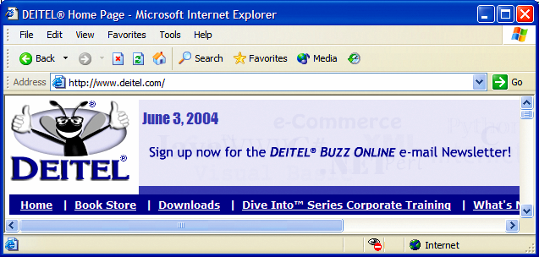
button
menus
title bar
menu bar
combo box
scroll
bars

Slide 8

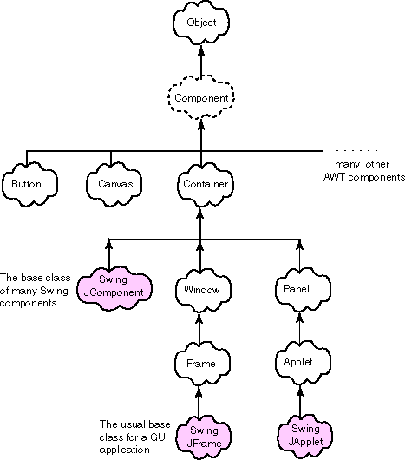
Checkbox, Choice,
Label, List,
Scrollbar,ScrollPane,
TextArea, TextField

Slide 9

Component contributes several public methods to all its subclasses:
public void setSize(int width, int height);
//set size in pixels
public void setBackground(Color c);
//see class Color for colors
public void setVisible(boolean b);
//Display on screen (creates peer)
Container is an abstract class:
  It cannot be instantiated; subclasses must implement some methods
  Container does implement some useful methods, including:
public Component add(Component comp);
//put a Component in a Container
public setLayout(LayoutManager mgr);
//lay out components in some pattern

Slide 10

A Window is a top-level window with no borders and no menubar
  It can generate a WindowOpened or a WindowClosed event,
to which a WindowListener or WindowAdapter can respond
A Frame is a top-level window with a title and a border
Because it has more features, it can generate more events:
WindowOpened, WindowClosing, WindowClosed,
WindowIconified, WindowDeiconified,
WindowActivated, WindowDeactivated
Respond to these events with a WindowListener
Once a subclass of Container has been constructed, it can add (attach) any AWT component within it, such as a Button, Label, TextField, or another Frame or Panel

Slide 11

//Demonstrates construction of a Container and a Button
import java.awt.*;
class Gui extends Frame
{
public Gui(String s) //constructor
{ super(s); //construct Frame part of Gui
setBackground(Color.yellow);
setLayout(new FlowLayout());
Button pushButton = new Button("press me");
add(pushButton);
}
} //class Gui
class Ex_1 //Creates an instance of class Gui
{ public static void main(String[] args)
{ Gui screen = new Gui("Example 1");
screen.setSize(500,100);
screen.setVisible(true);
}
} //class Ex_1
Superclass does not most of the work of creating an instance of Gui.
Modify properties of Gui.
Create a button and attach it to Gui.
Construct a Gui, set its size and make it visible.
What does this program not do?

Slide 12
//Program to demonstrate action listeners and event handlers
import java.awt.*;
import java.awt.event.*;
class Gui extends Frame implements ActionListener, WindowListener
{ public Gui(String s) //constructor
{ super(s);
setBackground(Color.yellow);
setLayout(new FlowLayout());
addWindowListener(this); //listen for events on this Window
Button pushButton = new Button("press me");
add(pushButton);
pushButton.addActionListener(this); //listen for Button press
}
//define action for Button press
public void actionPerformed(ActionEvent event)
{ final char bell = '\u0007';
if (event.getActionCommand().equals("press me"))
{ System.out.print(bell); }
}
//define methods in WindowListener interface
public void windowClosing(WindowEvent event) { System.exit(0); }
public void windowClosed(WindowEvent event) {} //do nothing
public void windowDeiconified(WindowEvent event){}
public void windowIconified(WindowEvent event){}
public void windowActivated(WindowEvent event){}
public void windowDeactivated(WindowEvent event){}
public void windowOpened(WindowEvent event){}
}
Attach a observer to “listen” for events that might occur on this window.
Create a simple button,
then add it to the Gui Frame.
Attach an observer to listen to events on this button.
When the ActionEvent labeled "press me" occurs, print (ring) the bell.
Listen for these events that can occur on a Window.

Slide 13
Uses event delegation model of JDK 1.1
When an event occurs, it generates an ActionEvent object
  ActionListener interface listens for a particular ActionEvent
  Responds in its actionPerformed method
WindowListener interface observes events triggered by Window object, such as closing it, and responds in corresponding methods
Program now has a live Button: actionPerformed method rings a bell
  Also a live close window button, which performs System.exit(0)
Most Components in the AWT have corresponding Listeners

Slide 14

Time consuming to define all interface methods
  WindowListener has seven methods
    What if we only want to use one?
    Required to define all methods in interface
Adapter class implements an interface
    Does anyone recognize a design pattern here?
    Default implementation ({ }, empty body) for all methods
  You then extend adapter class,
    overriding methods for events you care about, such as windowClosing.
  Has "is a" relationship with interface
    WindowAdapter is a WindowListener
    MouseAdapter is a MouseListener

Slide 15
See Sketchpad.java
(H:\oose\java, java Sketchpad)

Slide 16
Sketchpad uses hard-coded layout, which depends on a 800x600 screen
JDK provides a set of generic layout manager classes
Arrange Component objects within a Container object in predictable ways
FlowLayout (the default) add components one after another in rows:
GridLayout places components in cells of a grid:
setLayout(new GridLayout(3,2,5,5);
//3 rows, 2 columns, 5 pixel gaps
for (int counter=1; counter <= 6; counter++)
add(new Button(String.valueOf(counter)));
setLayout(new FlowLayout(FlowLayout.LEFT,10,10);
for (int counter=1; counter <= 6; counter++)
add(new Button(String.valueOf(counter)));
1 2 3
4 5 6
1 2
3 4
5 6
BorderLayout arranges components using along four sides
(North, South, East West) and Center positions

Slide 17
Defined in package javax.swing
Original GUI components from AWT in java.awt
  Heavyweight components - rely on local platform's windowing system for look and feel
Swing components are lightweight
  Not weighed down by GUI capabilities of platform
  More portable than heavyweight components
Swing components allow programmer to specify look and feel
  Can change depending on platform
  Can be same across all platforms

Slide 18
java.lang.Object
java.awt.Component
java.awt.Container
javax.swing.JComponent
Component defines methods used in its subclasses
  (for example, paint and repaint)
Container - collection of related components
  When using JFrame, add components to content pane
  (a Container)
JComponent - superclass to most Swing components

Slide 19
Pluggable look and feel
  Can look like different platforms, at run-time
Shortcut keys (mnemonics)
  Direct access to components through keyboard
Common event handling
  If several components perform same actions
Tool tips
  Describe component when mouse rolls over it

Slide 20

Menu Bar
  JMenuBar()
  add( JMenu )
Menu
  JMenu( String )
  add( JMenuItem )
JMenuItem( String )
JMenuItem( String,int )
JMenuBar mb = new JMenuBar(); //create a menu bar
JMenu fileMenu = new JMenu (“File”); //create a menu
mb.add( fileMenu ); //add menu to menu bar
setMenuBar( mb ); // add a menu bar to frame
fileMenu.setMnemonic( KeyEvent.VK_F ); // add a hotkey to menu
JMenuItem miOpen = new JMenuItem( “Open...”, KeyEvent.VK_O );
JMenuItem miExit = new JMenuItem( “Exit” );
fileMenu.add( miOpen ); // add a menu item
fileMenu.addSeparator(); // add a menu separator
fileMenu.add( miExit );

Slide 21
Labels
  Provide text instructions on a GUI
  Read-only text
  Programs rarely change a label's contents
  Class JLabel (subclass of JComponent)
Methods
  Can declare label text in constructor
  myLabel.setToolTipText( "Text" )
    Displays "Text" in a tool tip when mouse over label
  myLabel.setText( "Text" )
  myLabel.getText()

Slide 22
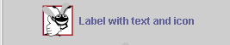
Icon
  Object that implements interface Icon
  One class is ImageIcon (.gif and .jpeg images)
    Assumed same directory as program
  Display an icon with JLabel’s setIcon method
    myLabel.setIcon( myIcon );
    myLabel.getIcon //returns current Icon
24 Icon bug = new ImageIcon( "bug1.gif" );
33 label3.setIcon( bug );

Slide 23
1 // Fig. 12.4: LabelTest.java
2 // Demonstrating the JLabel class.
3 import javax.swing.*;
4 import java.awt.*;
5 import java.awt.event.*;
6
7 public class LabelTest extends JFrame {
8 private JLabel label1, label2, label3;
Create a Container object, to which we attach JLabel objects (subclass of JComponent).
9
10 public LabelTest()
11 {
12 super( "Testing JLabel" );
13
Initialize text in JLabel constructor.
14 Container c = getContentPane();
15 c.setLayout( new FlowLayout() );
16
17 // JLabel constructor with a string argument
18 label1 = new JLabel( "Label with text" );
19 label1.setToolTipText( "This is label1" );
Set the tool tip text, and attach component to Container c.
20 c.add( label1 );
21
Create a new ImageIcon (assumed to be in same directory as program).
22 // JLabel constructor with string, Icon and
23 // alignment arguments
24 Icon bug = new ImageIcon( "bug1.gif" );
25 label2 = new JLabel( "Label with text and icon",
26 bug, SwingConstants.LEFT );
27 label2.setToolTipText( "This is label2" );
28 c.add( label2 );
29
Set ImageIcon and alignment of text in JLabel constructor.

Slide 24

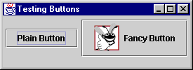
Methods of class JButton
  Constructors
  JButton myButton = new JButton( "Label" );
  JButton myButton = new JButton( "Label", myIcon );
  setRolloverIcon( myIcon )
    Sets image to display when mouse over button
Class ActionEvent getActionCommand
    returns label of button that generated event
Icon bug1 = new ImageIcon( "bug1.gif" );
fancyButton = new JButton( "Fancy Button", bug1 );
fancyButton.setRolloverIcon( bug2 );

Slide 25

When JCheckBox changes
  ItemEvent generated
    Handled by an ItemListener, which must define itemStateChanged
  Register handlers with with addItemListener
Class ItemEvent
  getStateChange
    Returns ItemEvent.SELECTED or ItemEvent.DESELECTED
private class CheckBoxHandler implements ItemListener {
public void itemStateChanged( ItemEvent e )

Slide 26
1 // Fig. 12.12: CheckBoxTest.java
2 // Creating Checkbox buttons.
3 import java.awt.*;
4 import java.awt.event.*;
5 import javax.swing.*;
6
7 public class CheckBoxTest extends JFrame {
8 private JTextField t;
9 private JCheckBox bold, italic;
10
11 public CheckBoxTest()
12 {
13 super( "JCheckBox Test" );
14
15 Container c = getContentPane();
16 c.setLayout(new FlowLayout());
1. import
1.1 Declarations
1.2 Initialize JCheckBoxes
1.3 Register event handler
17
18 t = new JTextField( "Watch the font style change", 20 );
19 t.setFont( new Font( "TimesRoman", Font.PLAIN, 14 ) );
20 c.add( t );
21
Create JCheckBoxes
22 // create checkbox objects
23 bold = new JCheckBox( "Bold" );
24 c.add( bold );
25
26 italic = new JCheckBox( "Italic" );
27 c.add( italic );
28
29 CheckBoxHandler handler = new CheckBoxHandler();
30 bold.addItemListener( handler );

Slide 27
31 italic.addItemListener( handler );
32
33 addWindowListener(
34 new WindowAdapter() {
35 public void windowClosing( WindowEvent e )
36 {
37 System.exit( 0 );
38 }
39 }
40 );
41
42 setSize( 275, 100 );
43 show();
44 }
Because CheckBoxHandler implements ItemListener, it must define method itemStateChanged
45
46 public static void main( String args[] )
47 {
48 new CheckBoxTest();
49 }
50
51 private class CheckBoxHandler implements ItemListener {
getStateChange returns ItemEvent.SELECTED or ItemEvent.DESELECTED
52 private int valBold = Font.PLAIN;
53 private int valItalic = Font.PLAIN;
54
55 public void itemStateChanged( ItemEvent e )
56 {
57 if ( e.getSource() == bold )
58 if ( e.getStateChange() == ItemEvent.SELECTED )
59 valBold = Font.BOLD;
60 else
61 valBold = Font.PLAIN;

Slide 28
Radio buttons
  Have two states: selected and deselected
  Normally appear as a group
    Only one radio button in group selected at time
    Selecting one button forces the other buttons off
  Mutually exclusive options
  ButtonGroup - maintains logical relationship between radio buttons
Class JRadioButton
  Constructor
    JRadioButton( "Label", selected )
    If selected true, JRadioButton initially selected

Slide 29
1 // Fig. 12.12: RadioButtonTest.java
2 // Creating radio buttons using ButtonGroup and JRadioButton.
3 import java.awt.*;
4 import java.awt.event.*;
5 import javax.swing.*;
6
7 public class RadioButtonTest extends JFrame {
8 private JTextField t;
9 private Font plainFont, boldFont,
10 italicFont, boldItalicFont;
11 private JRadioButton plain, bold, italic, boldItalic;
12 private ButtonGroup radioGroup;
13
14 public RadioButtonTest()
15 {
16 super( "RadioButton Test" );
1. import
1.1 Declarations
1.2 Initialization
17
18 Container c = getContentPane();
19 c.setLayout( new FlowLayout() );
Initialize radio buttons. Only one is initially selected.
20
21 t = new JTextField( "Watch the font style change", 25 );
22 c.add( t );
23
24 // Create radio buttons
25 plain = new JRadioButton( "Plain", true );
26 c.add( plain );
27 bold = new JRadioButton( "Bold", false);
28 c.add( bold );
29 italic = new JRadioButton( "Italic", false );
30 c.add( italic );

Slide 30
31 boldItalic = new JRadioButton( "Bold/Italic", false );
32 c.add( boldItalic );
33
34 // register events
35 RadioButtonHandler handler = new RadioButtonHandler();
Create a ButtonGroup. Only one radio button in the group may be selected at a time.
36 plain.addItemListener( handler );
37 bold.addItemListener( handler );
38 italic.addItemListener( handler );
39 boldItalic.addItemListener( handler );
40
41 // create logical relationship between JRadioButtons
42 radioGroup = new ButtonGroup();
Method add adds radio buttons to the ButtonGroup
43 radioGroup.add( plain );
44 radioGroup.add( bold );
45 radioGroup.add( italic );
46 radioGroup.add( boldItalic );
47
48 plainFont = new Font( "TimesRoman", Font.PLAIN, 14 );
49 boldFont = new Font( "TimesRoman", Font.BOLD, 14 );
50 italicFont = new Font( "TimesRoman", Font.ITALIC, 14 );
51 boldItalicFont =
52 new Font( "TimesRoman", Font.BOLD + Font.ITALIC, 14 );
53 t.setFont( plainFont );
54
55 setSize( 300, 100 );
56 show();
57 }
58

Slide 31
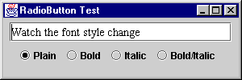
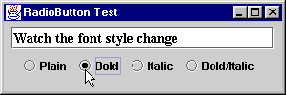
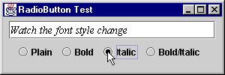
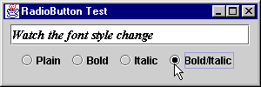

Slide 32
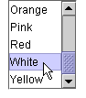
List
  Displays series of items
  may select one or more items
Class JList
  Constructor JList( arrayOfNames )
    Takes array of Objects (Strings) to display in list
  setVisibleRowCount( n )
    Displays n items at a time
    Does not provide automatic scrolling

Slide 33
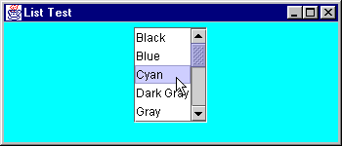
30 // create a list with the items in the colorNames array
31 colorList = new JList( colorNames );
32 colorList.setVisibleRowCount( 5 );
Initialize JList with array of Strings, and show 5 items at a time.
33
34 // do not allow multiple selections
35 colorList.setSelectionMode(
36 ListSelectionModel.SINGLE_SELECTION );
37
38 // add a JScrollPane containing the JList
Make the JList a single-selection list.
39 // to the content pane
40 c.add( new JScrollPane( colorList ) );
41
42 // set up event handler
Create a new JScrollPane object, initialize it with a JList, and attach it to the content pane.
43 colorList.addListSelectionListener(
44 new ListSelectionListener() {
45 public void valueChanged( ListSelectionEvent e )
46 {
47 c.setBackground(
48 colors[ colorList.getSelectedIndex() ] );
49 }
50 }
Change the color according to the item selected (use getSelectedIndex).
51 );
52
53 setSize( 350, 150 );
54 show();
55 }
56
57 public static void main( String args[] )
58 {
59 ListTest app = new ListTest();

Slide 34
1 // Fig. 12.20: MouseDetails.java
2 // Demonstrating mouse clicks and
3 // distinguishing between mouse buttons.
4 import javax.swing.*;
Another example, illustrating mouse events in AWT and Swing
5 import java.awt.*;
6 import java.awt.event.*;
7
8 public class MouseDetails extends JFrame {
9 private String s = "";
10 private int xPos, yPos;
11
Add a listener for a mouse click.
12 public MouseDetails()
13 {
14 super( "Mouse clicks and buttons" );
15
16 addMouseListener( new MouseClickHandler() );
17
18 setSize( 350, 150 );
19 show();
20 }
21
22 public void paint( Graphics g )
23 {
24 g.drawString( "Clicked @ [" + xPos + ", " + yPos + "]",
25 xPos, yPos );
26 }
27

Slide 35
28 public static void main( String args[] )
29 {
30 MouseDetails app = new MouseDetails();
31
32 app.addWindowListener(
33 new WindowAdapter() {
34 public void windowClosing( WindowEvent e )
35 {
Use a named inner class as the event handler. Can still inherit from MouseAdapter (extends MouseAdapter).
36 System.exit( 0 );
37 }
38 }
39 );
40 }
41
42 // inner class to handle mouse events
43 private class MouseClickHandler extends MouseAdapter {
44 public void mouseClicked( MouseEvent e )
45 {
Use getClickCount, isAltDown, and isMetaDown to determine the String to use.
46 xPos = e.getX();
47 yPos = e.getY();
48
49 String s =
50 "Clicked " + e.getClickCount() + " time(s)";
51
52 if ( e.isMetaDown() ) // Right mouse button
53 s += " with right mouse button";
54 else if ( e.isAltDown() ) // Middle mouse button
55 s += " with center mouse button";
56 else // Left mouse button
57 s += " with left mouse button";
58

Slide 36
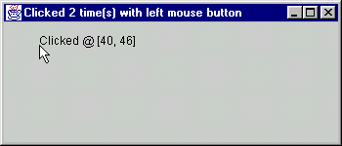
59 setTitle( s ); // set the title bar of the window
60 repaint();
61 }
Set the Frame’s title bar.
Program Output
62 }
63 }

Slide 37


http://java.sun.com/docs/books/tutorial/uiswing/components/componentlist.html

Slide 38
Separate user interface logic from "business logic" or model
AWT 1.1 "listeners" designed for this purpose; inner classes facilitate it further
Separation.java example illustrates this approach:
class BusinessLogic knows nothing about UI;
class Separation keeps track of all UI details and talks to BusinessLogic
through its public interface.
How is this design loosely coupled?
How does it support reuse?
How does it support legacy code?
Also note use of inner classes for all "listeners" nested within Separation
Contrast code of badidea1.java: look at code in actionPerformed:
public void actionPerformed(ActionEvent e)
{ Object source = e.getSource();
if (source == b1)
System.out.println("Button 1 pressed");
else if (source == b2) System.out.println("Button 2 pressed");
else System.out.println("Something else");
}
badidea2.java improves on things by using adapters, but ...
Why is the cascaded if above a bad idea?

Slide 39

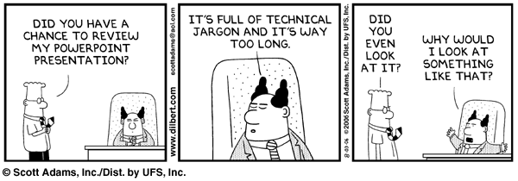

Slide 40
Standard Widget Toolkit (SWT)
  GUI toolkit released in November 2001
  Initially designed for the Eclipse IDE
  “Best of both worlds” approach – use native functionality when available, and Java implementation when unavailable
  Takes on the appearance and behavior of the native platform
  The code YOU write will be portable for all the platforms that have SWT implementations
  http://www.eclipse.org/swt/ - SWT home page

Slide 41

Netbeans (Sun)
JBuilder (Borland)
Eclipse (IBM and others)
  Visual Editor
    Help → Software Updates → Find and Install…

Slide 42
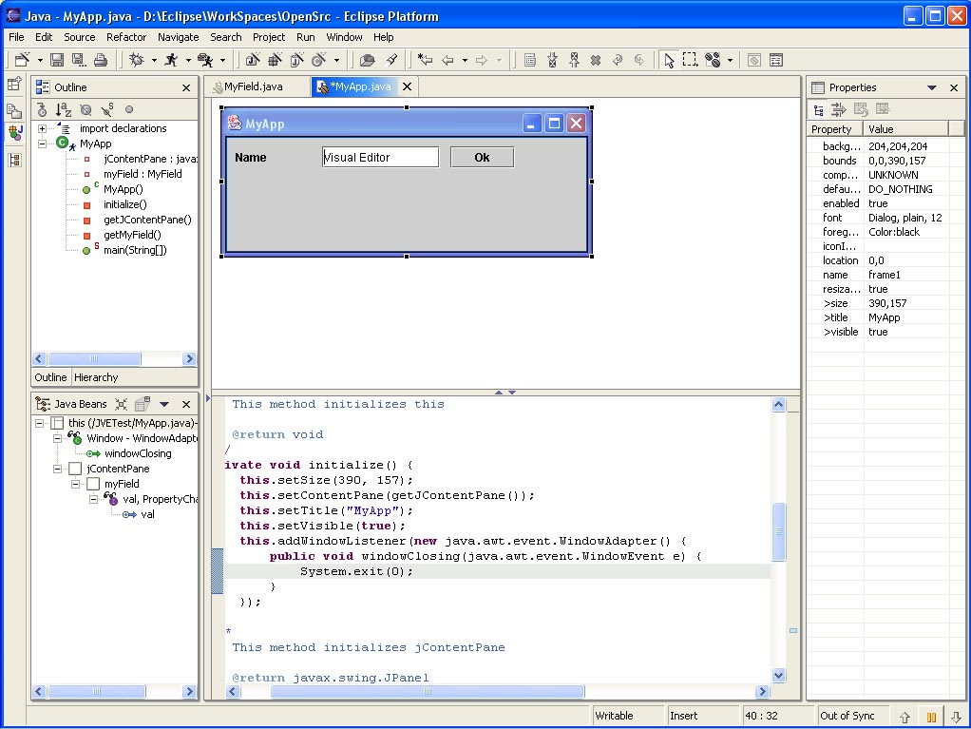

Slide 43
